Slide 1
Stochastic Gradient Descent (SGD)

Slide 2
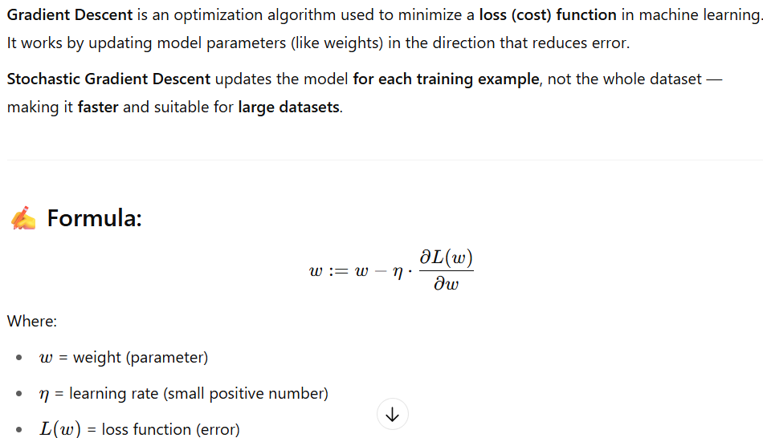
What is Stochastic Gradient Descent (SGD)?

Slide 3
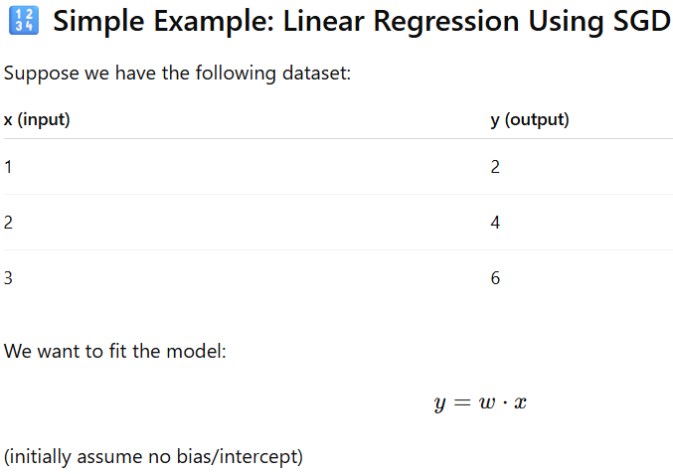
What is Stochastic Gradient Descent (SGD)?

Slide 4
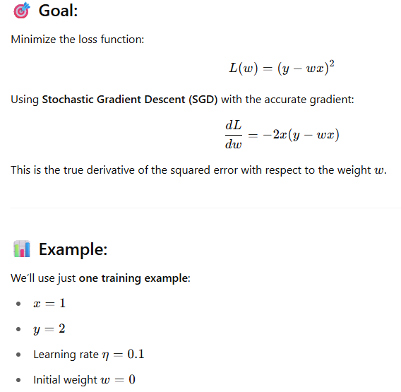
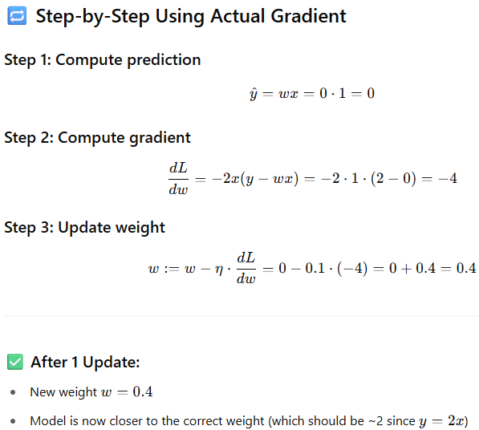
What is Stochastic Gradient Descent (SGD)?

Slide 5
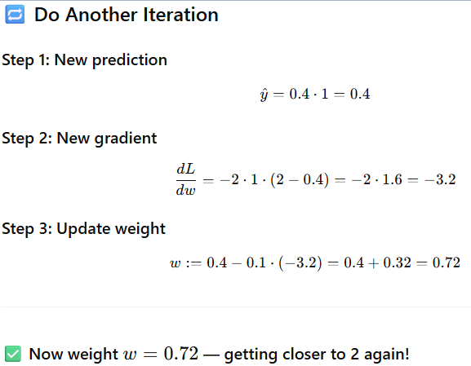
What is Stochastic Gradient Descent (SGD)?

Slide 6
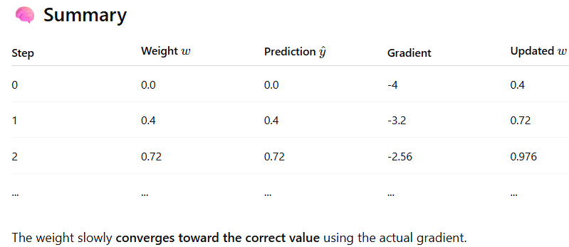
What is Stochastic Gradient Descent (SGD)?

Slide 7
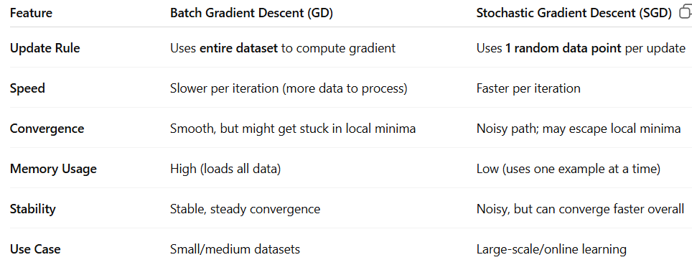
Stochastic Gradient Descent (SGD) vs Batch Gradient Descent (GD)

